Slide 1

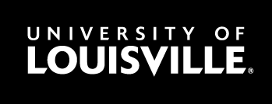
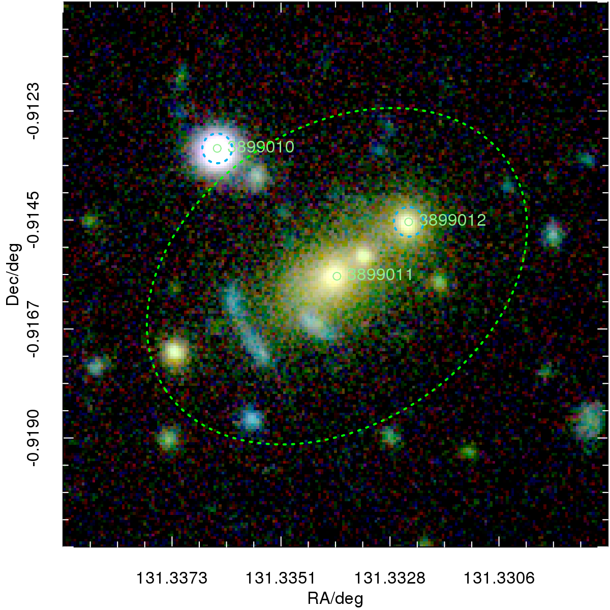
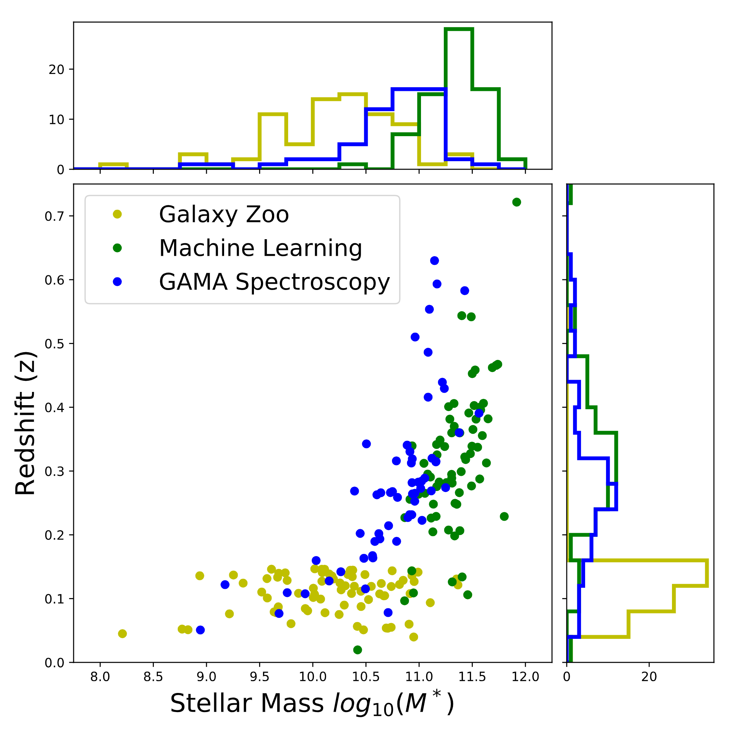
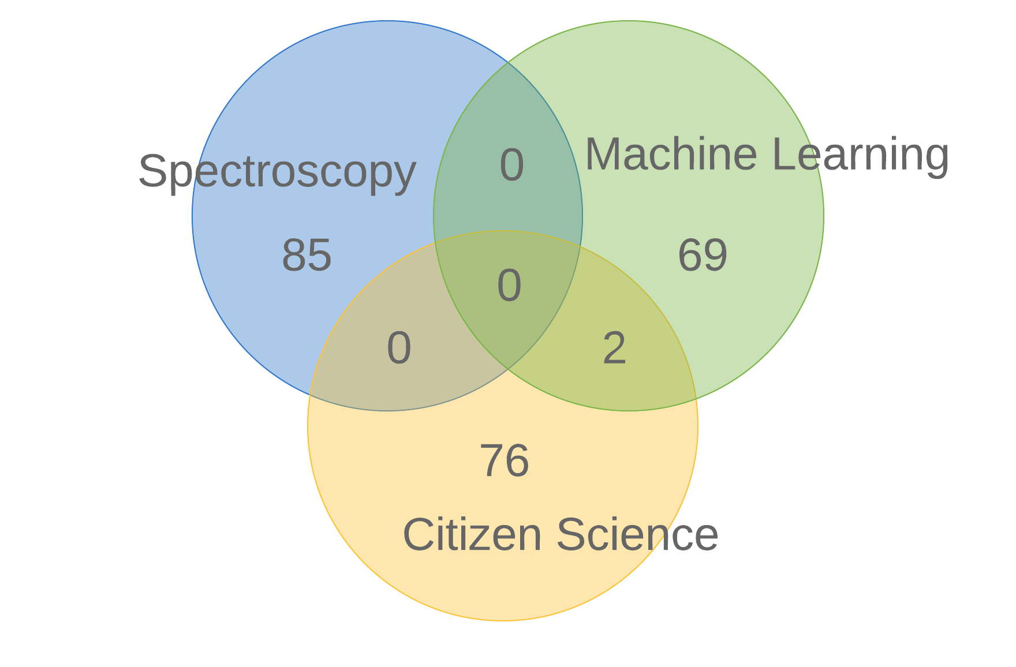
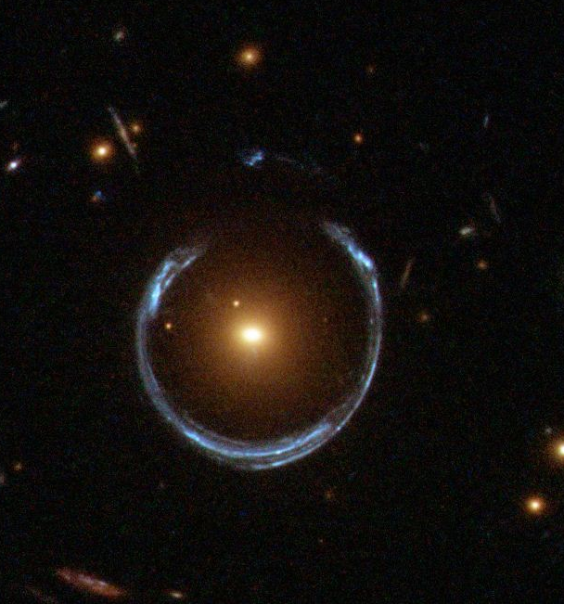
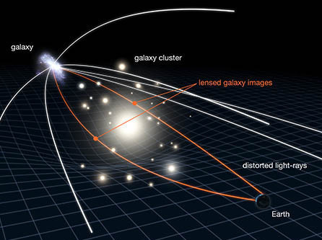
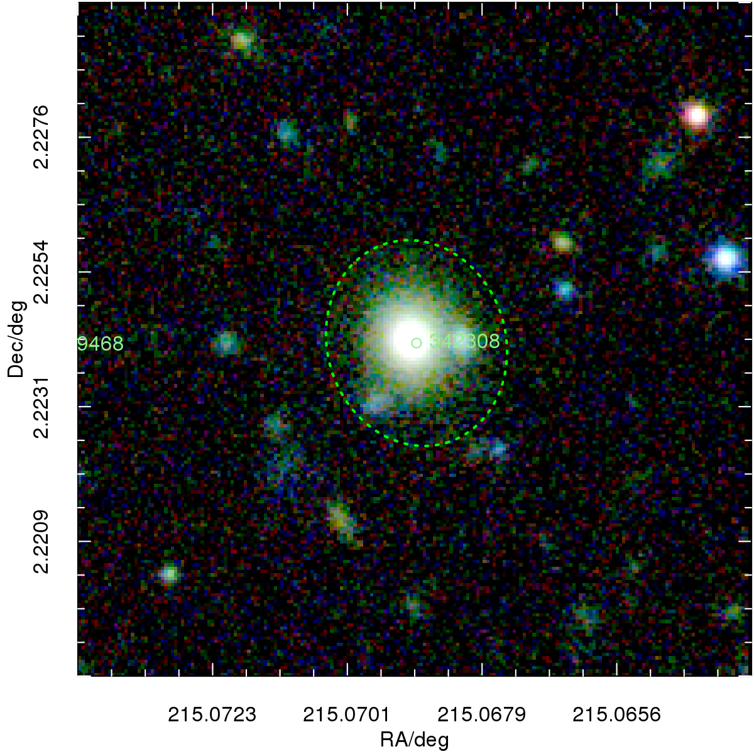
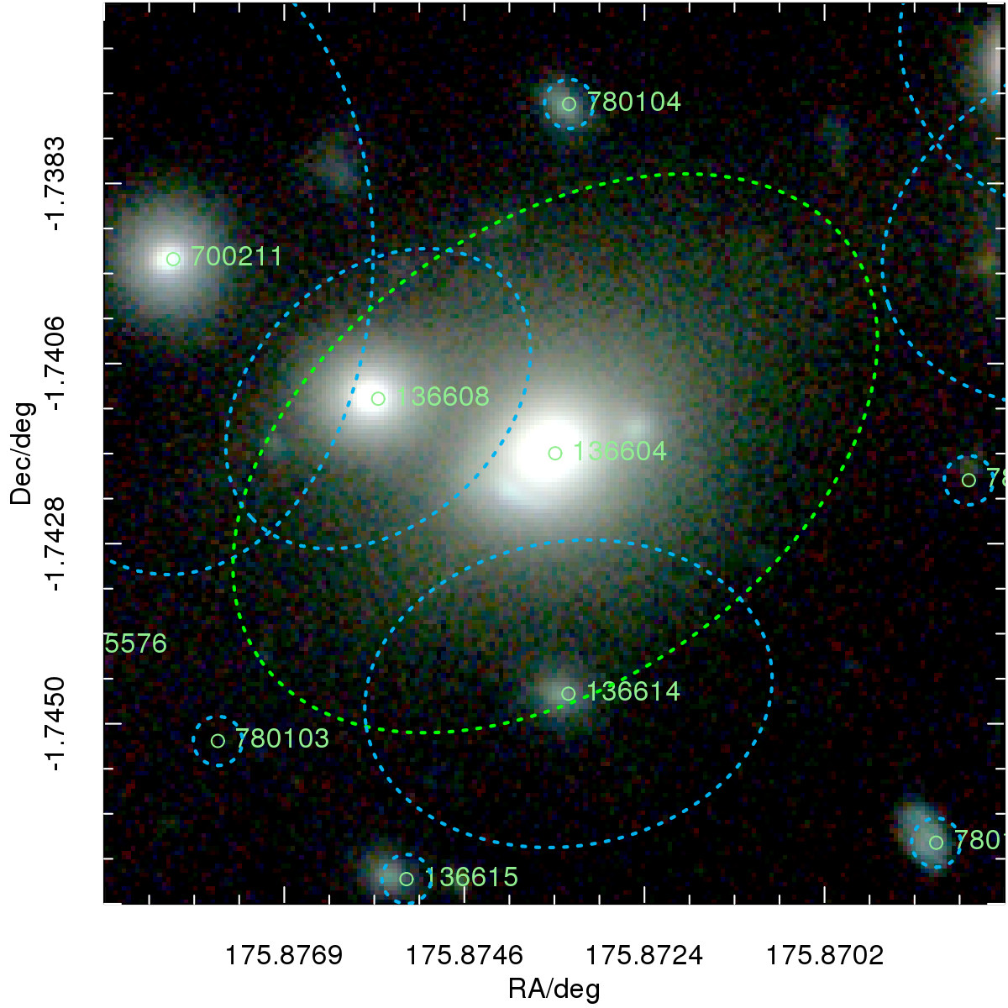
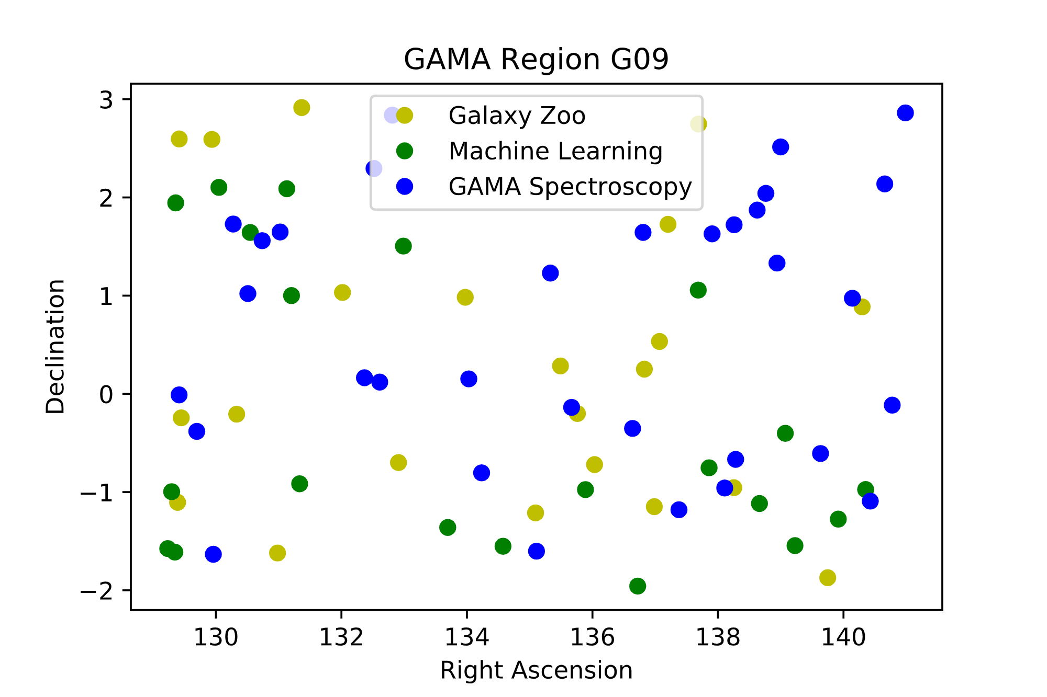
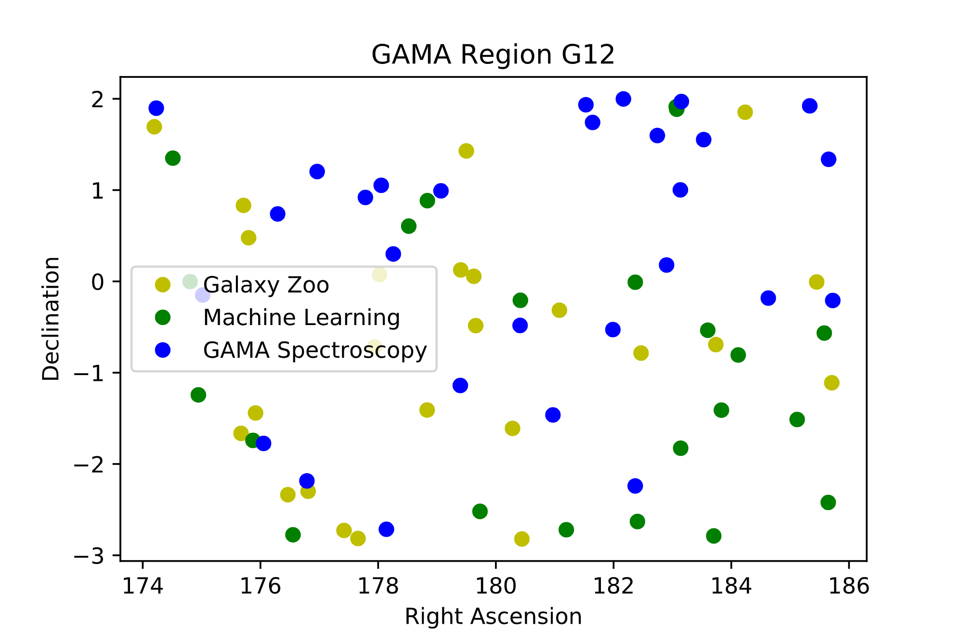
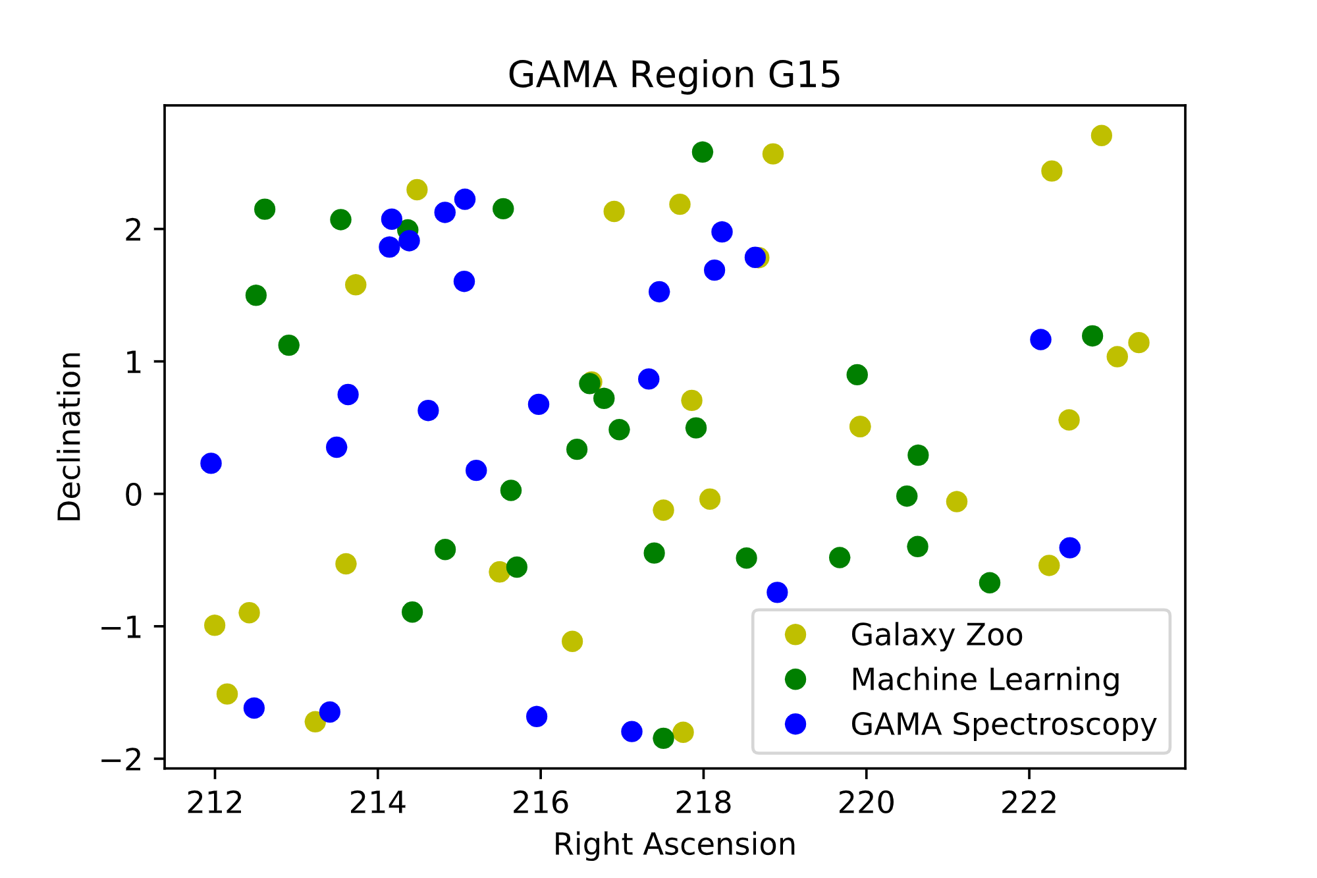

Galaxy and Mass Assembly: A Comparison of Lens Searches in GAMA/KiDS
Contact:
Shawn Knabel
shawn.knabel@louisville.edu
502-407-9364
Shawn Knabel, Benne Holwerda, and Becky Steele
Department of Physics and Astronomy, University of Louisville
What are gravitational lenses?
Mixed Spectroscopy:
Identifies blended galaxy spectra by fitting measured spectra against galaxy templates. If two galaxies are present, two distinct matches will show at different redshifts.
Machine Learning:
Identifies cases of lensing by training computers to recognize features of lensing galaxies using training sets consisting of previously found lenses and artificially created ones.
These are rare cases of alignment of two galaxies whereby light from the farther galaxy is bent by the gravity of the closer galaxy, causing it to appear distorted from the observer’s point of view.
These events offer us insight into the nature of gravity, dark matter, and other unanswered cosmological questions, as well as allowing us to measure properties of both galaxies.
The trouble is finding enough of these strong gravitational lenses for further study.
Conclusions:
Credit: NASA & ESA Hubble Space Telescope
Credit: NASA, ESA & L. Calçada
The three methods in question cannot be used to vet each other because they find characteristically different lens candidates.
Although incomplete on its own, the machine learning approach has the potential to improve with the addition of candidates identified through other methods.
Complementary use of all three methods, focused on enhancing the scope and accuracy of machine learning’s training sets, will allow for the identification of more (and more varied) lensing systems than previously estimated.
Three Methods on Equal Grounds
For the first time, all three detection methods in question have been used on the same regions of the sky, where two large-scale galaxy surveys (GAMA and KiDS) overlap.
Citizen Science:
GalaxyZoo is designed to involve the public in the scientific process. Participants classify images by answering a guided series of questions, one of which identifies an “Arc or Lens” feature in the image.
G136604 was identified by both Machine Learning and GalaxyZoo. Its mass (2.866*10¹¹ solar masses) and redshift (z =0.106) place this candidate in the region of overlap between the two methods in the above-right graph of mass vs. redshift.
References:
B. W. Holwerda et al., 2015, MNRAS 449, 4227-4287
C. E. Petrillo et al., 2016, MNRAS 000, 1-19
C. E. Petrillo et al., 2018, MNRAS 000, 1-18
Funded by Summer Research Opportunity Program (SROP)
directed by the Office of the Executive Vice President for Research and Innovation and the Office of the Provost at the University of Louisville.
Notes:
Genigraphics® has provided this template to assist in preparation of a medical or scientific research poster. The dimensions are set to 36” high by 56” wide but prints can be scaled up or down in size to any dimension with a 9:14 aspect ratio. For example, if you order a 45” x 70” poster using this template, we will print the file at 125% of its original size. The most critical factor is that your template and poster dimensions must be proportional:
$$\frac{template height}{template width} = \frac{desired print height}{desired print width}$$

